Slide 1
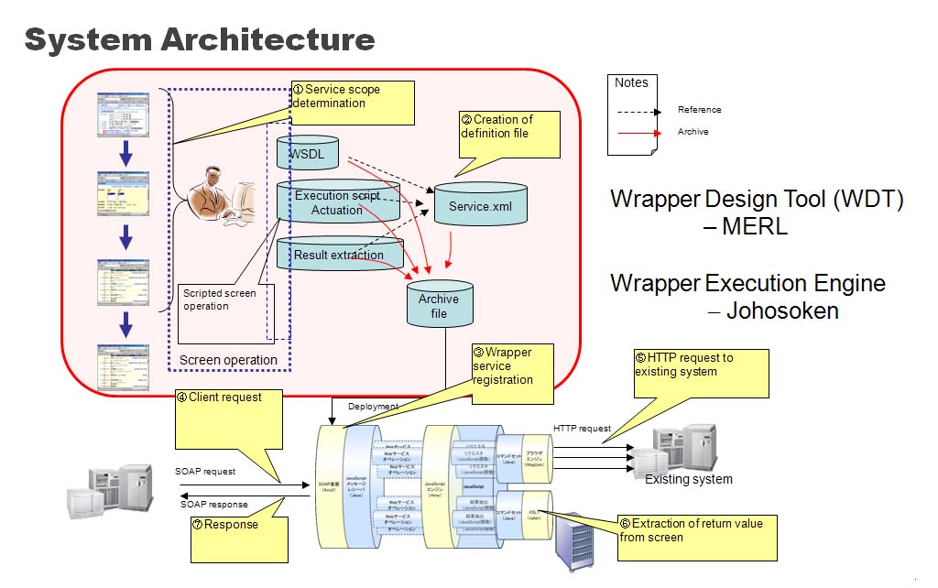
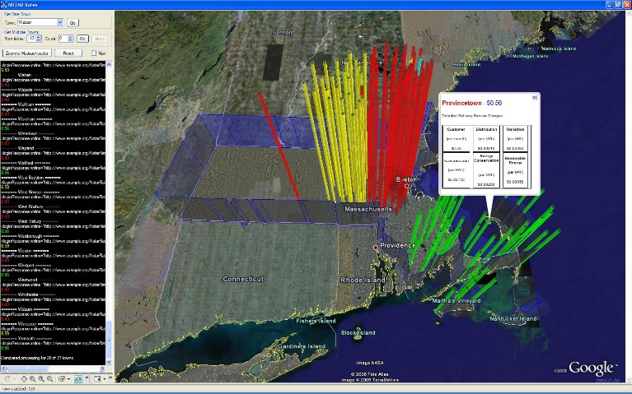
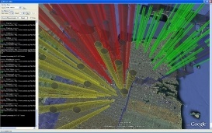
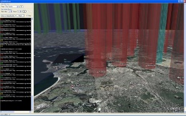
SOA Integration Technology Project
Objective: develop technology for “servicizing” existing enterprise web applications
convert existing web applications used by humans to standard web services to be used by computers in an enterprise software framework.
Deliverable: The Wrapper Design Tool is a Firefox extension for converting existing web applications to web services for use in an SOA framework
The software backbone of the Smart Grid will be based on SOA/Web Services
W3C SOAP 1.2, WSDL 2.0, UDDI, XML 1.0, WS-I Basic Profile 1.1, WS-Addressing, WS-Security, WS-Reliability, WS-Transaction, HTTP 1.1 , HTML 4
Paper: "Semi-Supervised Information Extraction from Variable-Length Web-Page Lists", International Conference on Enterprise Information Systems, Milan, Italy, Daniel Nikovski and Alan Esenther Patent Application: "Method for Extracting Data from Web Pages" Nikovski, Esenther
Notes:
SOA = Service-Oriented Architecture: New software engineering architecture where services expose their functionality via XML messages and standard protocols. Successor to Object Orientation and Component-Orientation approaches; SOA is not tied to language or platform.
NSTAR example application: we wrapped the NSTAR electric utility web page with a web service that lets us extract rate information for each town and display it in an interactive 3D map.

Slide 3
